Slide 1

SǪL and Databases:
Project Report
By: <ADITYA BHAT>
Proprietary content. © Great Learning. All Rights Reserved. Unauthorized use or distribution prohibited.

Slide 2
Business Overview
Total Revenue
Total Orders
Total Customers
Avg Rating
48.61 M
1000
1000
3.06
Last Ǫtr Revenue
Last Ǫtr Orders
Avg Days to Ship
% Good Feedback Last Qtr
8.5 M
199
105
10.05%

Slide 3
Customer Metrics

Slide 4
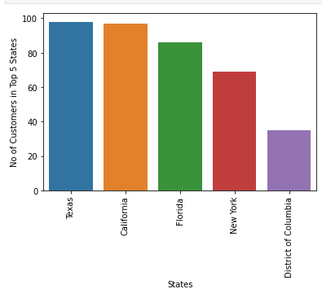
Distribution of Customers across States
Observations / Findings
●Texas has the most number of customers and Wyoming, Maine and Vermont has the least number of customers
● Most of the customers are from states with high population

Slide 5
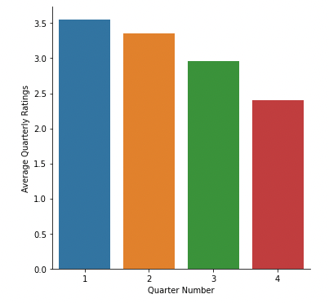
Average Customer Ratings by Ǫuarter
Observations / Findings
● The average rating is decreasing over time with the 1st quarter having 3.5 stars on average to the last quarter with 2.3 stars ratings

Slide 6
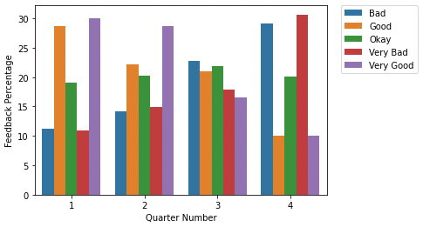
Trend of Customer Satisfaction
Observations / Findings
●Customers seem to be dissatisfied over time as the the number of bad and very bad feedback is significantly higher in the 3rd and 4th quarter versus the 1st and 2nd
●The number of customers who were neither too satisfied or dissatisfied (okay category) is about the same every quarter
●The service is deteriorating over time which is evident from the customer feedback. Maybe they need to invest more in customer services department by hiring more people or improve training for existing personnel

Slide 7
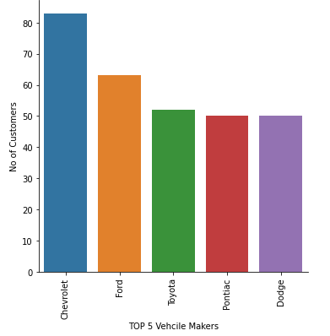
Top Vehicle makers preferred by customers
Observations / Findings
● Chevrolet is the most popular vehicle brand preferred by the customers followed by ford
●It looks like customers prefer American manufacturers over international manufacturers

Slide 8
Most preferred vehicle make in each state (Top 10 states with Most customers)
STATE | Vehicle Maker
Texas | Chevrolet
Florida | Toyota
California | Ford, Chevrolet, Nissan Dodge, Audi
Ohio | Chevrolet
Alabama | Dodge
Colorado | Chevrolet
Maryland | Ford
New York | Toyota, Pontiac
Virginia | Ford
Washington | Chevrolet

Slide 9
Revenue Metrics

Slide 10
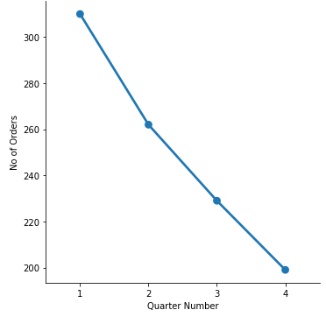
Trend of purchases by Ǫuarter
Observations / Findings
● The number of orders is decreasing over time which might be correlated with customer satisfaction or lack of inventory

Slide 11
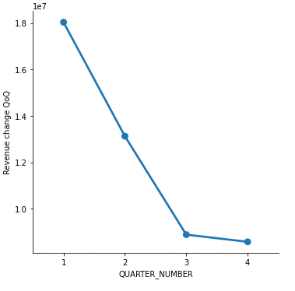
Ǫuarter on Ǫuarter % change in Revenue
Quarter Number | Revenue change (%)
1 | NaN
2 | -27.2
3 | -32.31
4 | -3.4
Observations / Findings
●The Revenue is decreasing every quarter
● There is nearly 32.3% decrease in revenue between 2nd and 3rd Quarter
● The revenue loss seems to be stabilizing in the 4th quarter

Slide 12
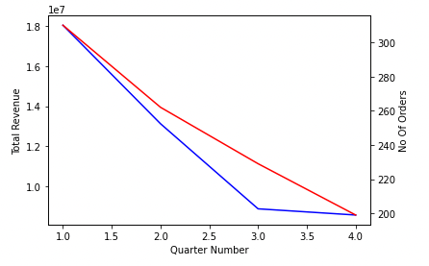
Trend of Revenue and Orders by Ǫuarter
Observations / Findings
● The revenue and no of orders are decreasing over time which is evident from the line plot above and are highly correlated

Slide 13
Shipping Metrics

Slide 14
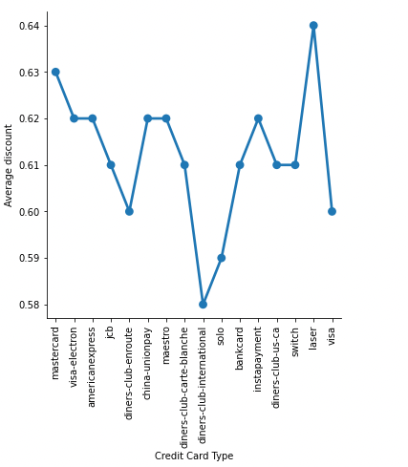
Average discount offered by Credit Card type
Observations / Findings
● The average discount ranges from 58% to 64% depending on the card type
●Diners club international has the smallest discount and Laser credit card has the highest discount

Slide 15
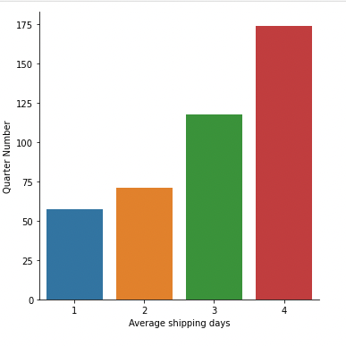
Time taken to ship orders by Ǫuarter
Observations / Findings
● Average time to ship the car from the order date is significantly increasing every quarter
● The average ship times are three times higher in the 4th quarter when compared to 1st quarter

Slide 16
—

Slide 17
Insights and Recommendations
Insights:
● The customer feedback is changing significantly from very good to very bad over the quarters
● The revenue and number of orders are also significantly decreasing
● The average shipping days are also significantly increasing every quarter
Recommendations:
● Hire more personnel across the board and especially in customer service
●Optimize the time taken to ship the orders by better planning by maybe increasing the inventory which might help reduce the delay in shipping
●Provide training for personnel to improve customer service
●Decrease the discount provided for each credit card
●Target states with highest customer base (TX,FL,CA,NY,DC) to improve sales
●Focus on targeting sales for American manufactured vehicles to increase the number of orders

